Slide 1

Contract Monthly Claim System (CMCS)
Part 3: Automation & Database Integration
Jeron Okkers | ST10447759 | Module: PROG6212

Slide 2


Project Overview
The Goal
Part 3 Focus
Data Persistence
A web-based application streamlining independent contractor claim submissions, designed for efficiency and accuracy.
Evolution from a static prototype to a fully functional, database-driven solution with enhanced capabilities.
Implementing robust SQL Server integration for reliable and permanent data storage.
Enhanced Security
Process Automation
Implementing Role-Based Access Control (RBAC) for HR, Lecturers, Coordinators, and Managers.
Integrating server-side calculations and validation logic to streamline operations and reduce manual errors.

Slide 3
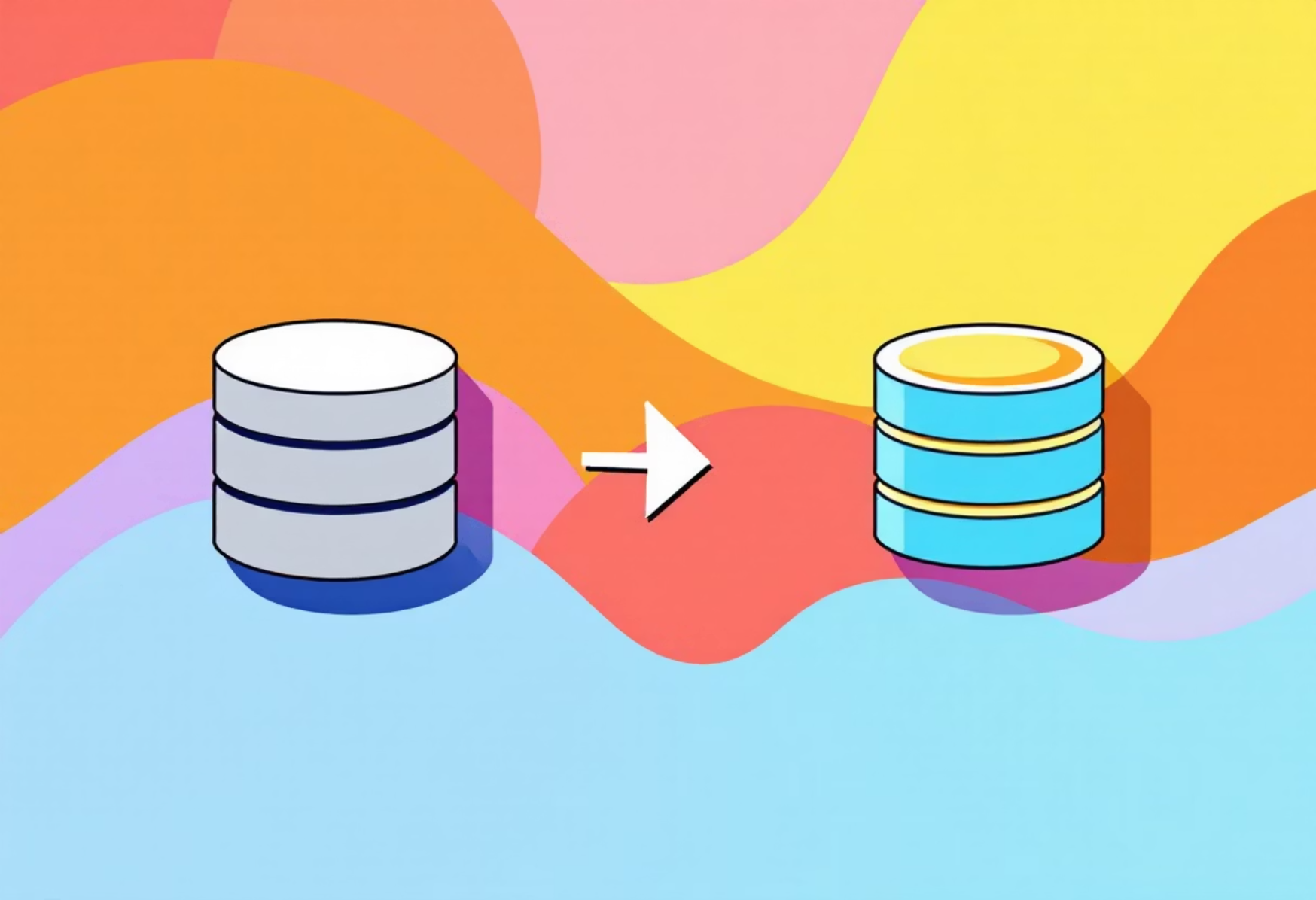


Feedback Implementation & Upgrades
Addressing previous limitations to meet production standards and enhance system reliability.
Data Storage
Part 2: In-Memory Lists (Volatile data lost on restart).
Part 3:SQL Server & Entity Framework Core (Persistent, reliable storage).
User Identity
Part 2: Hardcoded simulation with limited control.
Part 3:ASP.NET Identity (Secure Login/Logout & Role Management).
Rate Management
Part 2: Manual input (High risk of fraud and errors).
Part 3:HR Automation (Rates pulled from DB, read-only for Lecturers).

Slide 4
System Architecture
Built on a modern, robust, and secure technology stack.
Framework
Database
ASP.NET Core MVC (.NET 8.0) for high-performance web applications.
SQL Server LocalDB for efficient and scalable data management.
ORM
Authentication
Entity Framework Core (Code-First) for seamless database interaction.
Microsoft.AspNetCore.Identity for secure user authentication and authorization.
Frontend
Security
Razor Views, Bootstrap 5, and jQuery for a responsive and intuitive user interface.
[Authorize] attribute enforcement for granular access control.

Slide 5

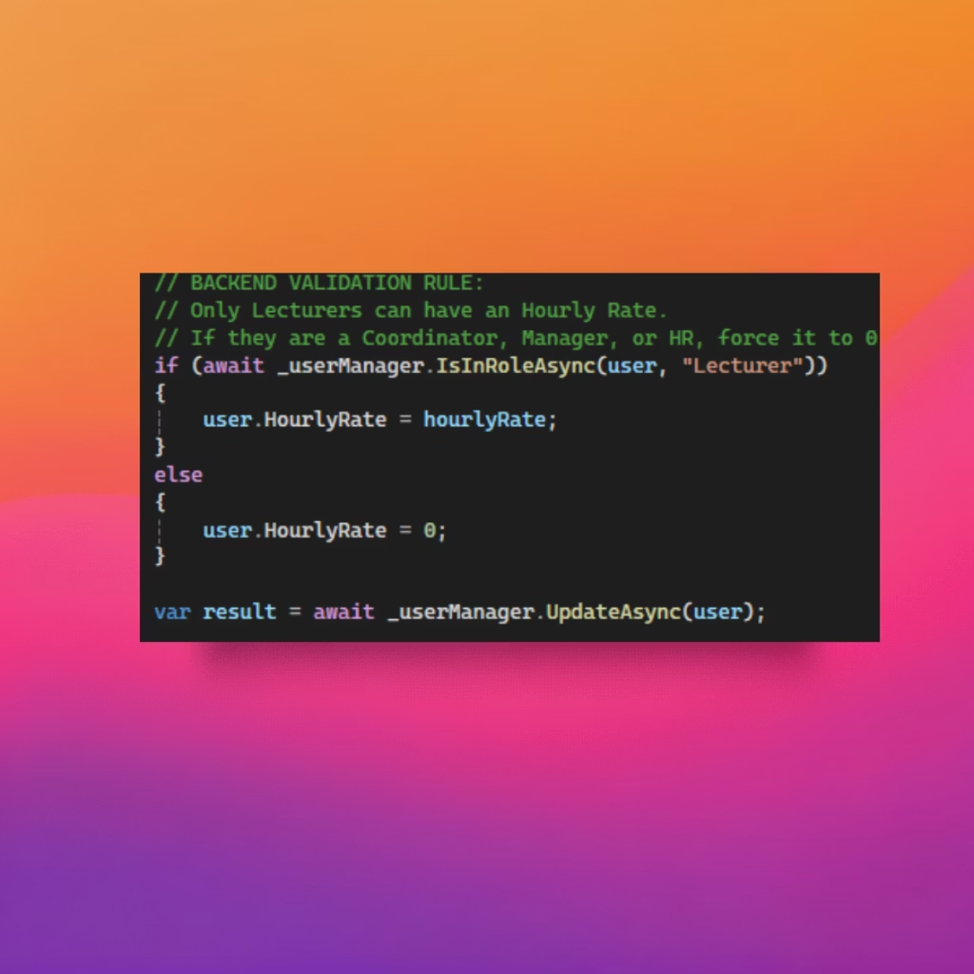
Feature 1: HR "Super User"
HR Automation & User Management
The HR "Super User" functionality provides strict control over user roles and pay rates, ensuring data integrity and compliance.
Requirement: Strict control over user roles and pay rates.
The Logic: Backend checks user roles during updates, preventing unauthorized modifications.
The Code: If a user is not a Lecturer, their HourlyRate is forcibly set to 0 to prevent accidental or malicious data entry.
The Benefit: Prevents payroll errors and data corruption by administrative staff, enhancing system reliability and trust.

Slide 6

Feature 2: Lecturer Automation
Automated Claims & Validation
Lecturer claim submissions are now fully automated and validated, significantly reducing manual review and error rates.
Auto-Calculation: The controller ignores form input for hourly rates, pulling the correct HourlyRate directly from the database.
Security: This prevents "Inspect Element" tampering, ensuring claims are based on authorized rates.
Validation Rule: Any claim exceeding 180 hours per month is automatically rejected, enforcing company policy.
The Benefit: Enforces company policy automatically without manual review, leading to greater efficiency and compliance.

Slide 7
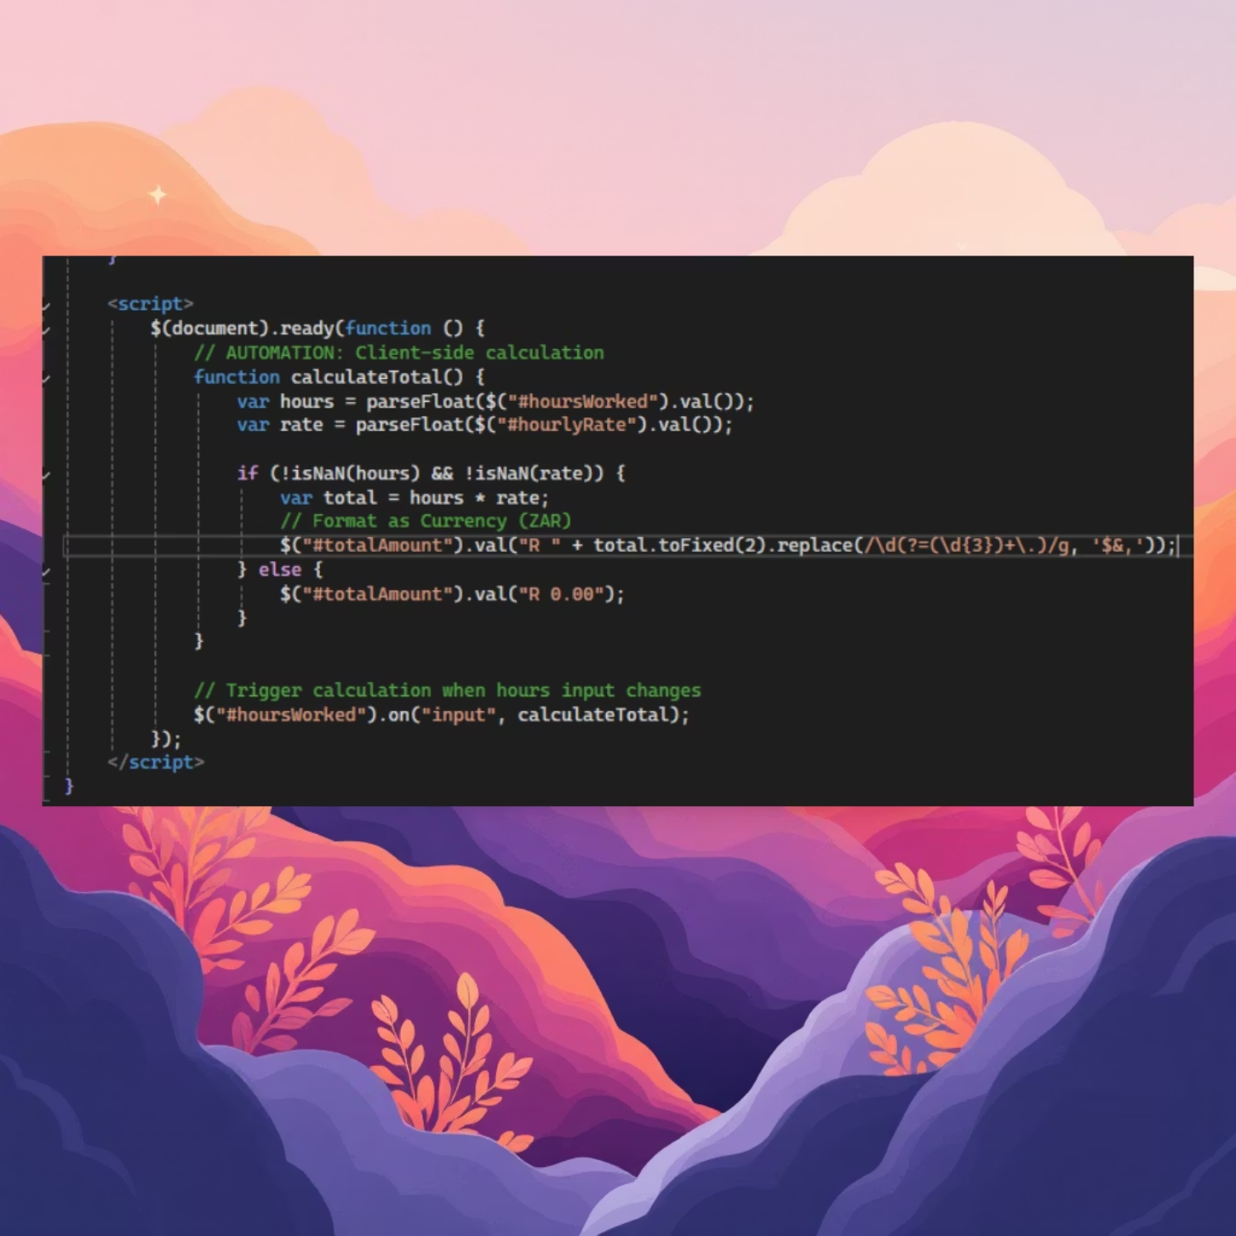
Feature 3: UX Automation
Client-Side Experience (UX)
The user experience is enhanced with real-time feedback and instant calculation, minimizing errors and improving transparency.
Real-time Feedback: A jQuery listener on the "Hours Worked" input provides immediate updates.
Instant Calculation: The system instantly displays the calculated payout (Hours * Rate), allowing users to see their earnings before submission.
Visuals: The HourlyRate field is locked and set to read-only, ensuring it cannot be manually altered.
The Benefit: Users know their exact payout before submitting, which significantly reduces errors and queries post-submission.

Slide 8
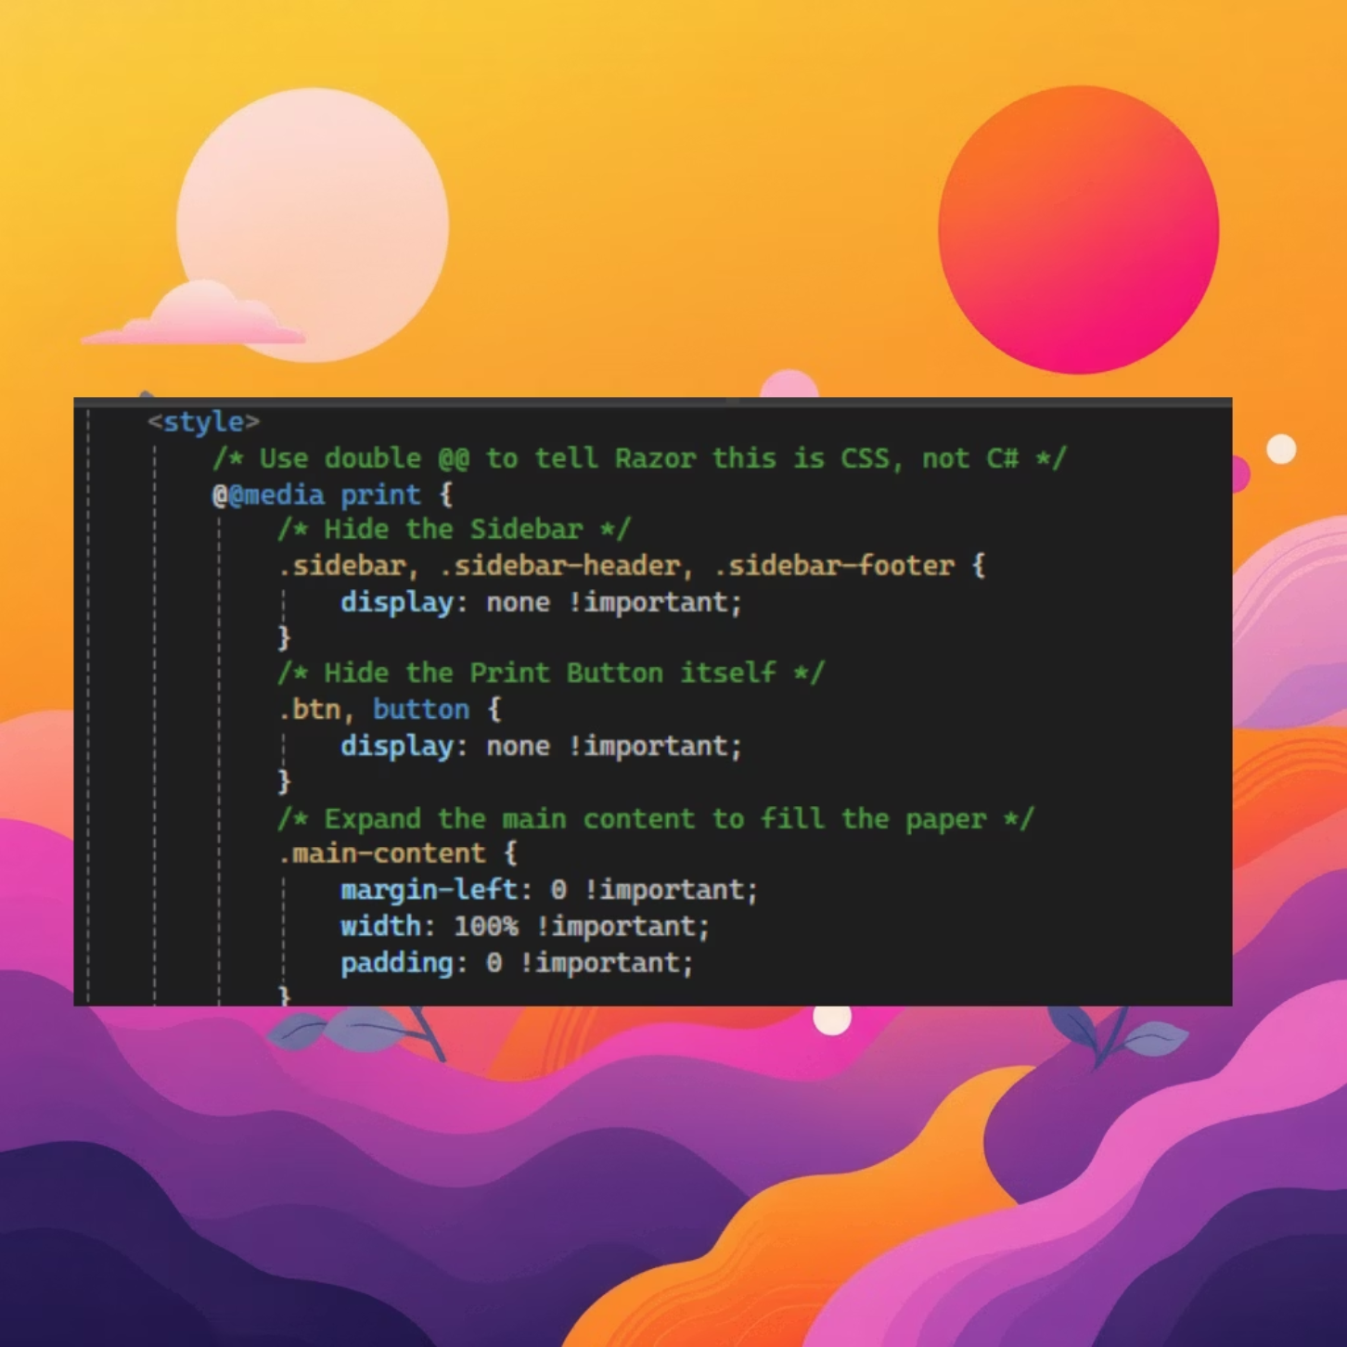
Feature 4: Reporting
Reporting & Invoice Generation
The system now supports robust reporting capabilities, allowing for the generation of standardized, audit-ready PDF invoices.
Requirement: The need to generate standardized PDF reports for auditing and record-keeping purposes.
The Solution: Utilizes custom CSS @media print queries for optimized print layouts.
The Logic: When the print dialog opens, navigation, sidebars, and buttons are automatically stripped away, providing a clean report format.
The Benefit: Enables native "Save as PDF" functionality without the need for heavy external libraries, reducing system overhead and complexity.

Slide 9

Project Conclusion
The CMCS has evolved into a secure, production-ready web application.
It successfully separates concerns, giving distinct roles to HR for data management, Lecturers for claims submission, and Admins for approvals. The system fully meets all Part 3 requirements for robust database integration and advanced process automation, demonstrating significant progress and functionality.

Slide 10

Thank You
Q&A
We appreciate your time and attention. We are now open to any questions you may have about the Contract Monthly Claim System.

